Slide 1

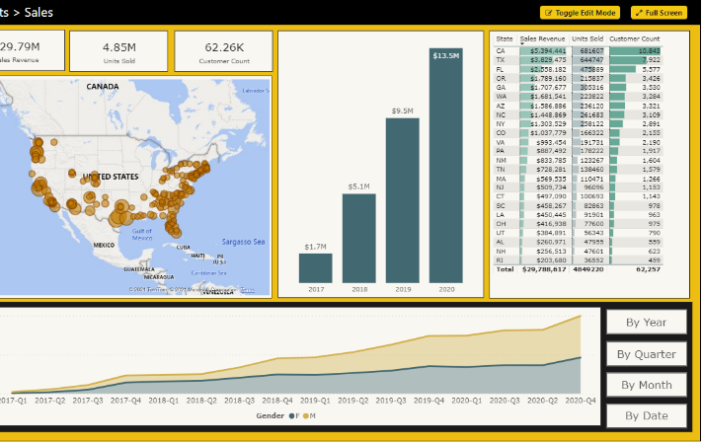
Microsoft Power BI
PBICAT
Building Multi-language Reports in Power BI
Ted Pattison Power BI Customer Advisory Team (PBICAT)

Slide 2
Agenda
Overview of Multi-language PBIX Development
Designing Multi-language Reports
Adding Metadata Translations with TOM
Designing Data Models to Support Content Translations

Slide 3
Introduction to Building Multi-language Reports in Power BI
Power BI provides Internationalization and localization features
These features make it possible to build multi-language reports
Design a report that renders in English, Spanish, French, German or Dutch
It's no longer necessary to maintain a separate PBIX project file per language
Building multi-language reports will decrease maintenance and overhead

Slide 4
Building multi-language reports is tricky and non-intuitive
Some parts of Power BI are designed to support localization, others are not
Adding localization support requires advanced tooling and/or custom code
Report authors must avoid techniques that do not support localization
Learning What Not To Do is more important than learning What To Do
Many existing Power BI reports will require redesign from ground up

Slide 5
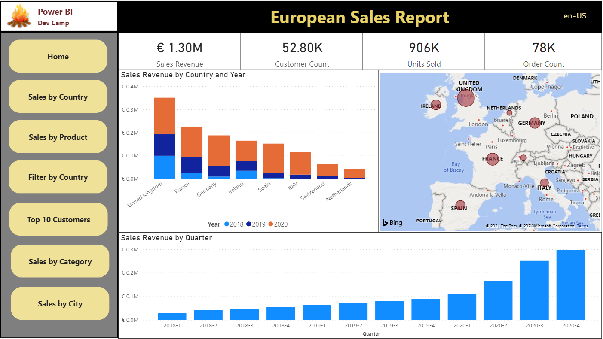
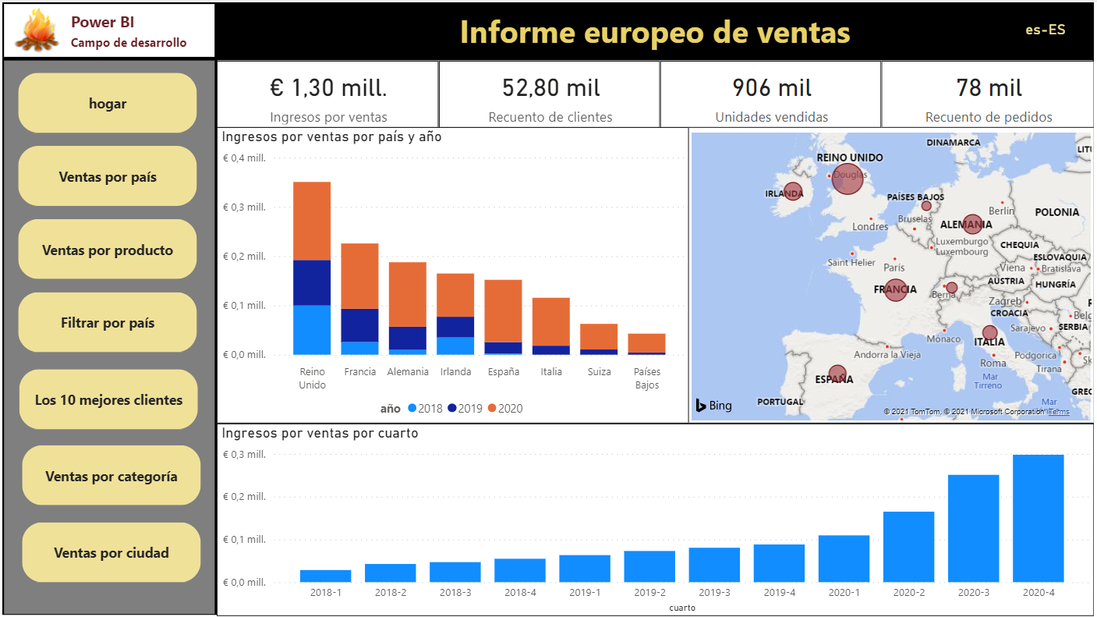
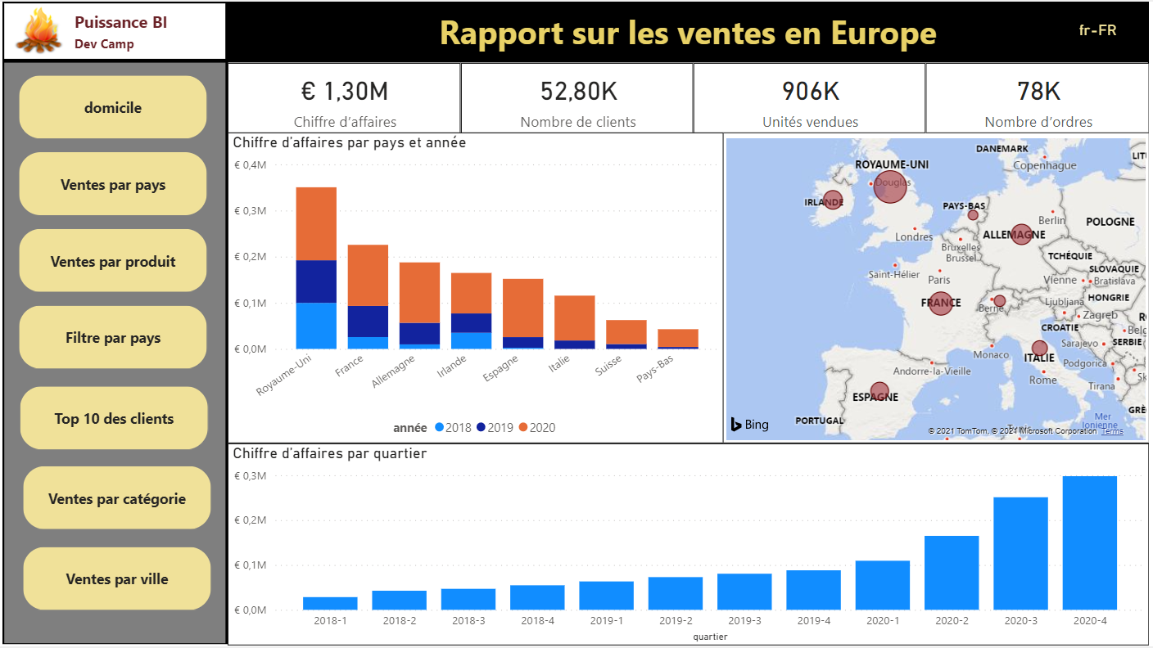
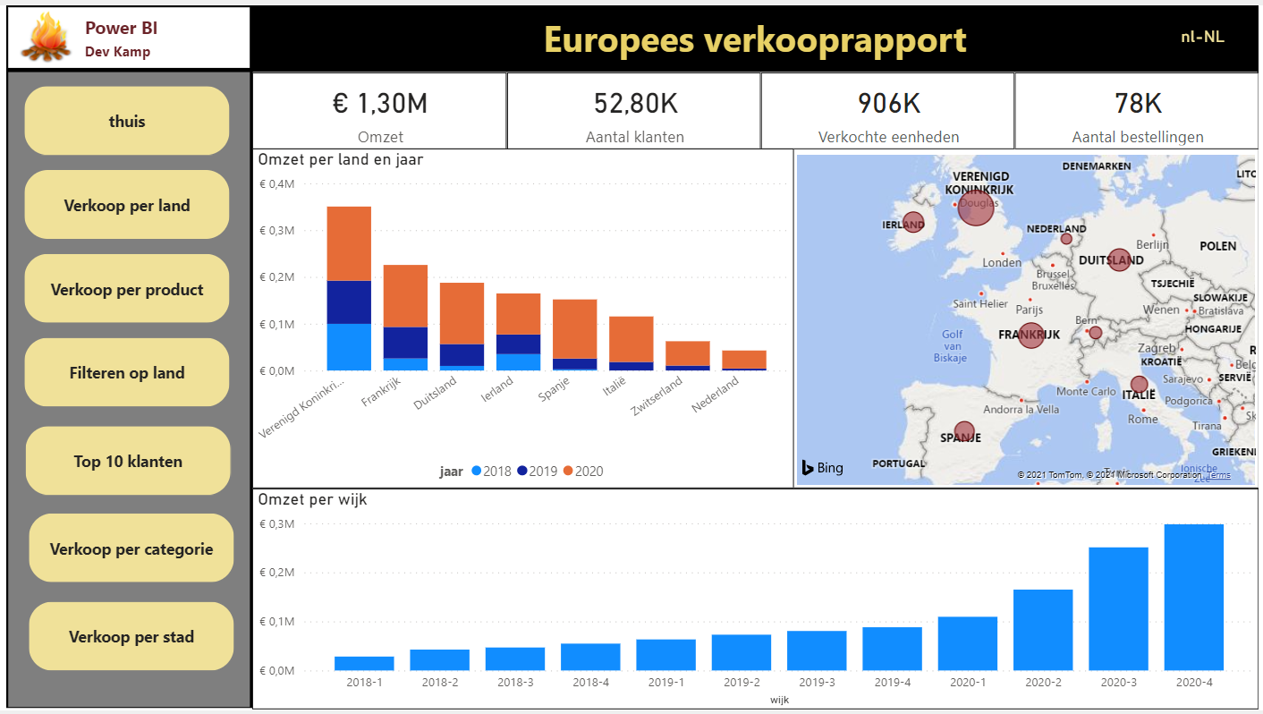

European Product Sales Demo
Live demo at https://multilanguagereportdemo.azurewebsites.net/
English
Spanish
French
German
Dutch

Slide 6
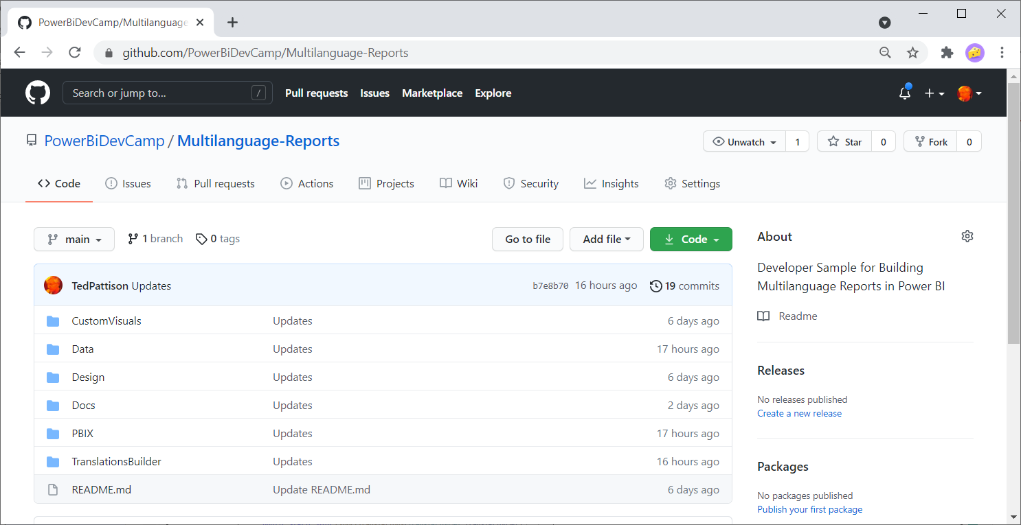
GitHub Repository for Multilanguage-Reports Sample
All sample code for this developer samples available for download
https://github.com/PowerBiDevCamp/Multilanguage-Reports

Slide 7
Metadata Translations versus Content Translations
Power BI support for localization is integrated at the dataset level
Report designer has no explicit support for localizing headers, labels and captions
Metadata translations supported for table names and field name
Metadata translations support localizing table names and field names
Metadata translations not used to localize content (e.g. Product name or Country names)
Metadata translations currently require Power BI Premium – not supported in shared capacity
Content translations added using specific data model design strategy
Best practices currently based on replicated rows pattern
PBIX File
Report Layout
no knowledge of translations
Dataset Definition
supports translations

Slide 8
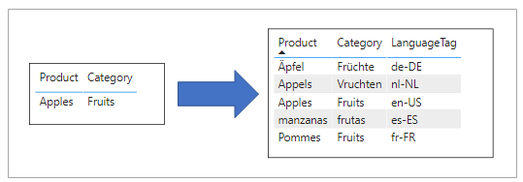
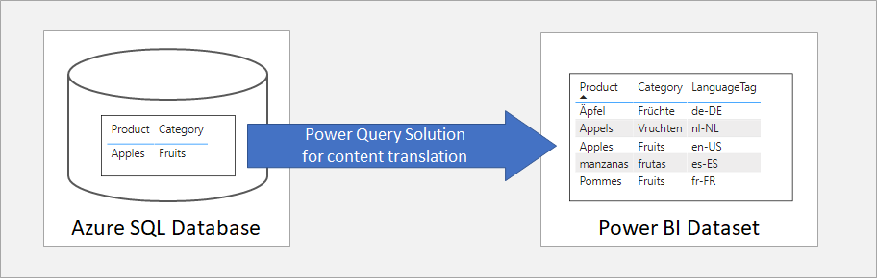
Understanding Content Translation
Best design pattern for content translation in Power BI is row replication
Power Query can add value in row replication design strategy

Slide 9
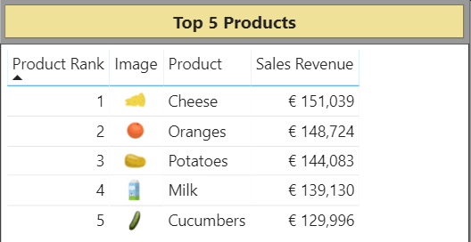
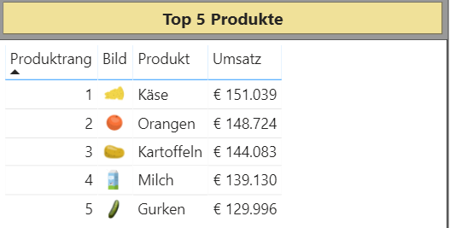
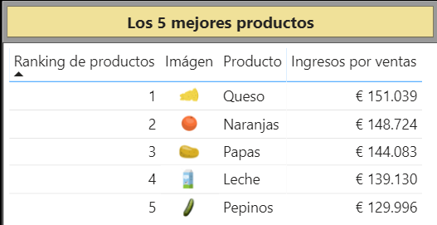
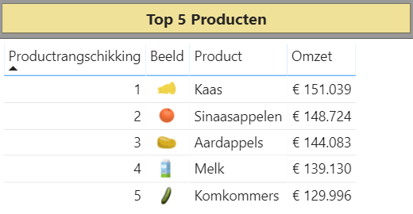
Metadata Translations Combined with Content Translations

Slide 10
Workflow for Multi-language PBIX Development
Use Power BI Desktop to prepare PBIX to support translations
Design data model with tables, columns, measure and hierarchies
Create Localized Labels table with measures with localizable names
Add metadata translations to PBIX
Add metadata translations to PBIX project using External Tool support
Requires using Tabular Editor or programming Tabular Object Model (TOM)
Design and implement content translation strategy (if required)
Content translation design based replicated rows pattern
Can be implemented using Power Query and translation lookup tables

Slide 11
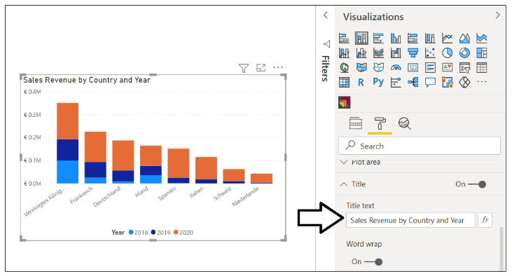
Using Dynamic Visual Titles
Dynamic visual titles will use translations for column and measure names
They are automatically translated when using dataset translations
Do not set visual title using literal text
Language | Visual Title
English | Sales Revenue by Country and Year
Spanish | Ingresos por ventas por país y año
French | Chiffre d’affaires par pays et année
German | Umsatz nach Land und Jahr
Dutch | Omzet per land en jaar

Slide 12
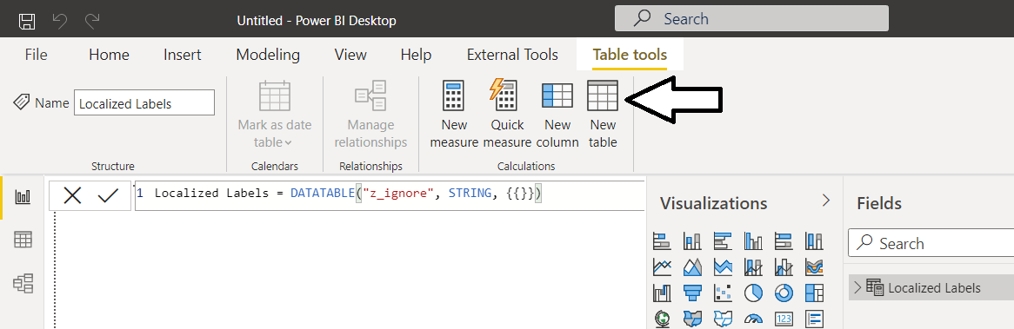
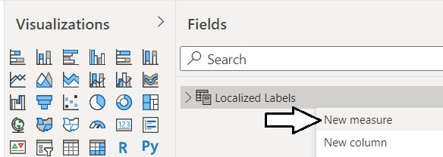
Creating the Localized Label Table
Localized Label table provides strategy for translating headers and captions
Strings that require localization are created as measures
Localized labels build on top of Power BI feature to localize measure names
How to get started
Create the Localized Label table
Add a new measure for each string that requires localization

Slide 13
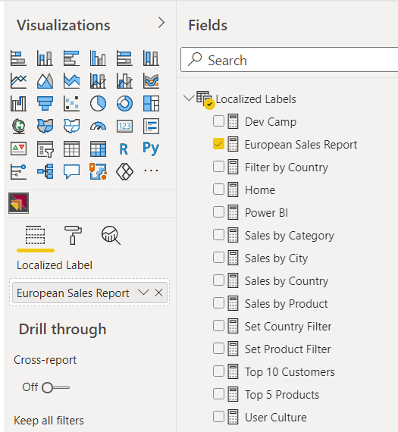
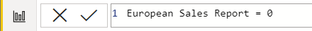
Localized Labels Table
Create a new table in data model named Localized Labels
Add a measure for any string content that needs to be localized
Set measure expressions to 0

Slide 14
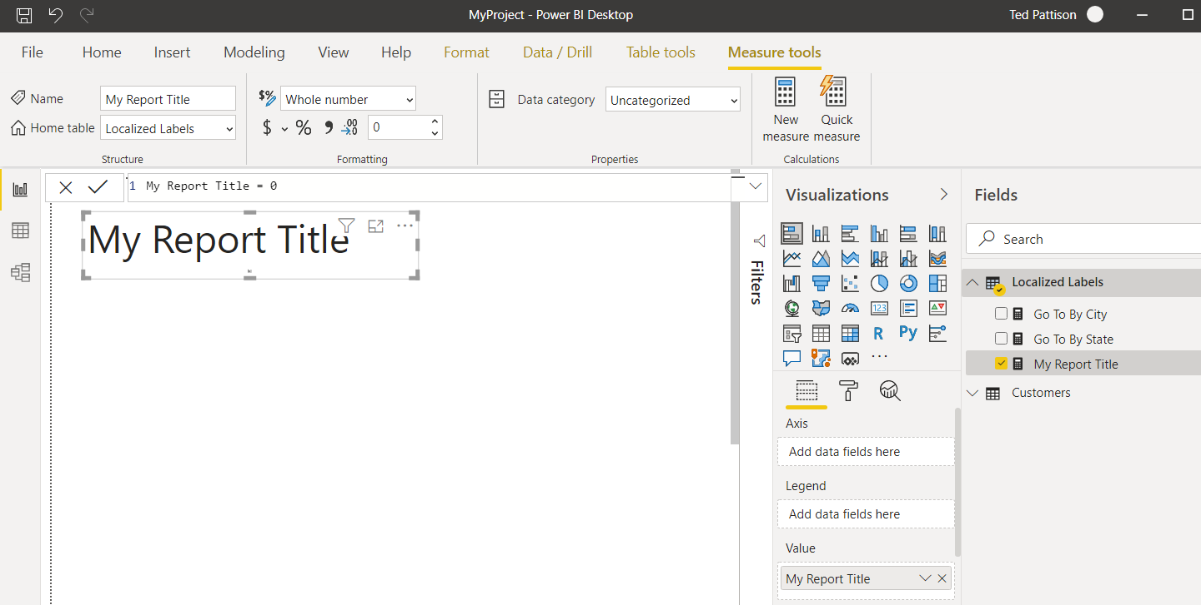
Surfacing a Localized Label
You can surface localized label using one of core Power BI visuals
Add Stacked Barchart visual and add localized label in Values data roles

Slide 15
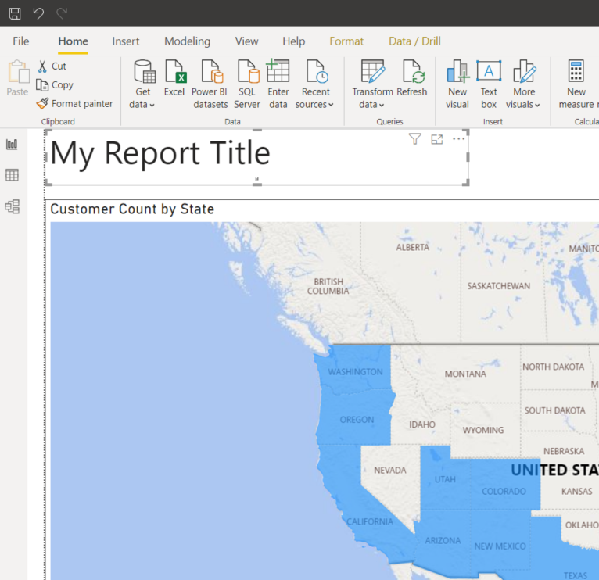
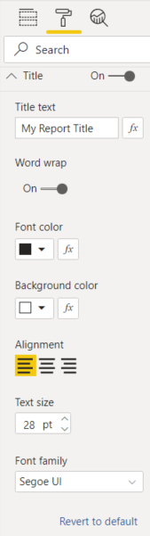
Configuring Localized Label Display Properties
Using Format pane to configure label display properties
Design experience for this technique is limited

Slide 16
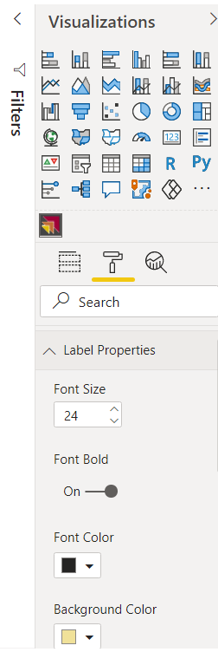
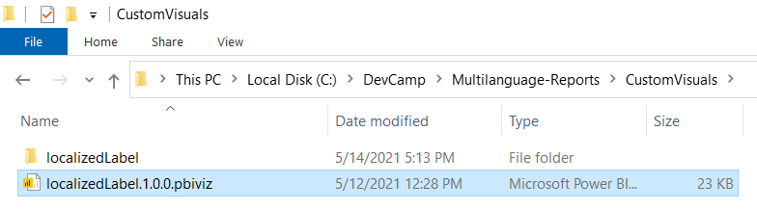
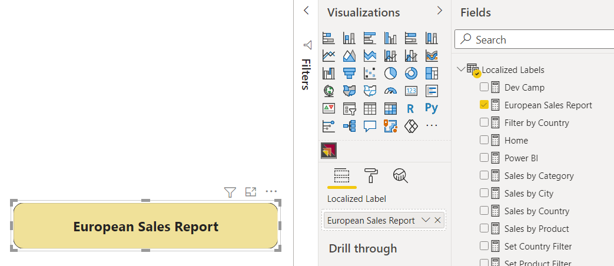
Developing a Custom Visual: LocalizedLabel
Using a custom visual to surface localized labels
Sample provides custom visual project
Provides more flexibility in configuring display properties

Slide 17
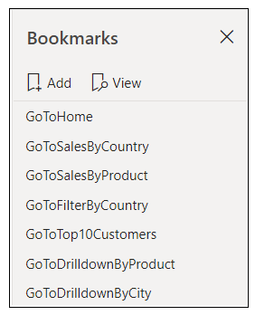

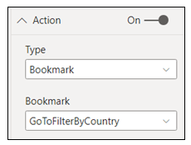
Designing Navigation
Page tabs do not support localization – they should be hidden from user
Page-to-page navigation can be designed with shapes and bookmarks
Shape
Localized Label

Slide 18
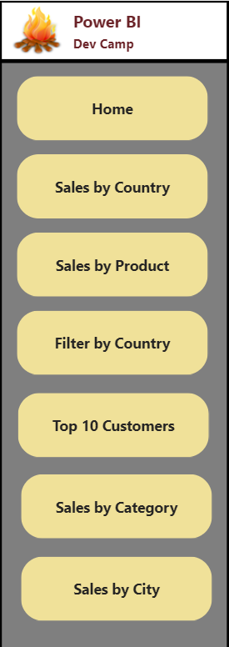
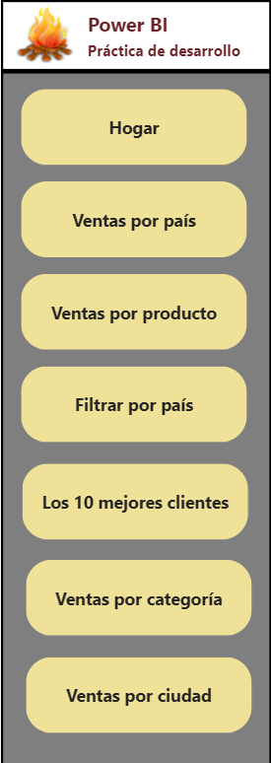
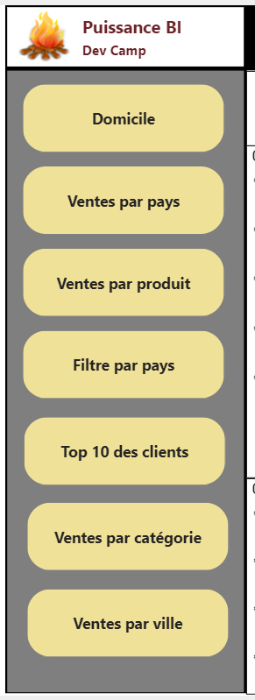
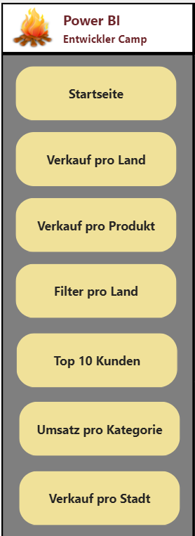
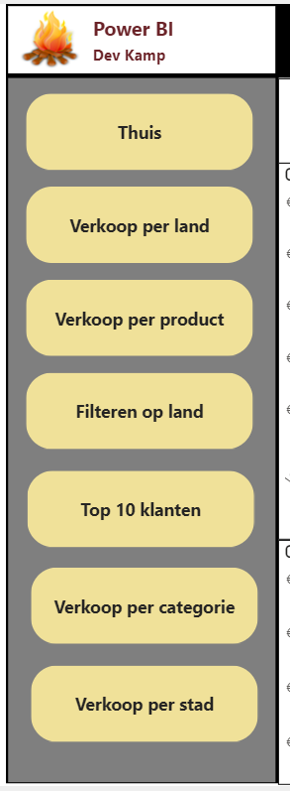
Translating Button Captions

Slide 19
Adding Dataset Translations
You can add dataset translations into PBIX project file
You can add/manage dataset translations on datasets running in Power BI Service
Tabular
Editor
Power BI Desktop
PBIX Project File
Dataset
Custom Code using TOM
Tabular
Editor
Power BI Service
Premium Workspace
XMLA
Endpoint
Dataset
Custom Code using TOM

Slide 20
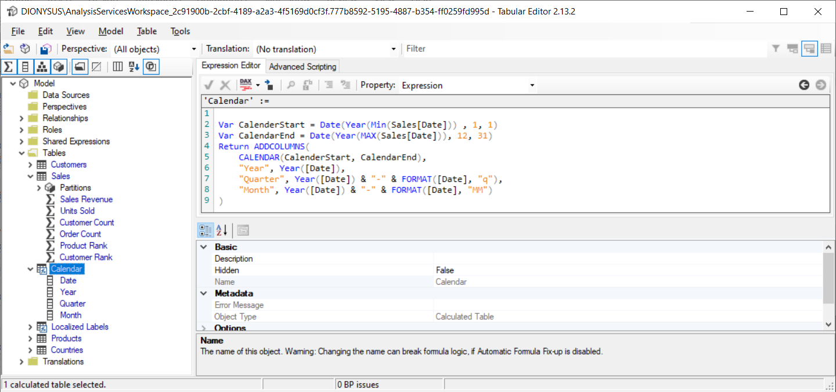
Working with Tabular Editor
Download from https://github.com/otykier/TabularEditor/
Everything can be done using free edition of Tabular Editor (v2)

Slide 21
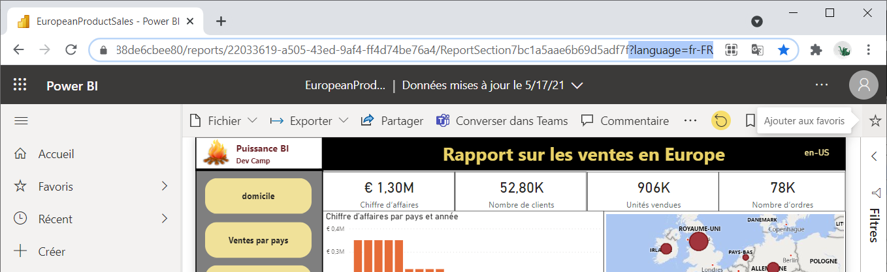
Loading Reports with Locale using a Query String Parameter
You can load report using specific locale
Add language query string parameter to report URL
Requires workspace in dedicated capacity
This technique will not change result for UserCulture function in DAX

Slide 22
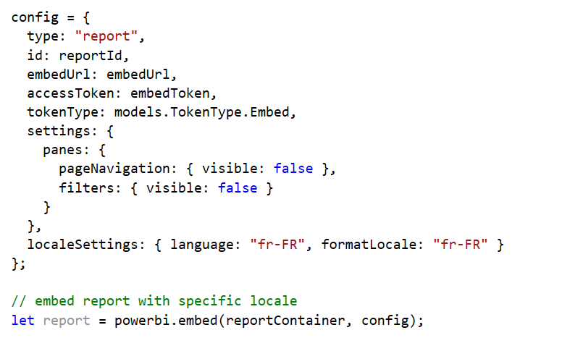
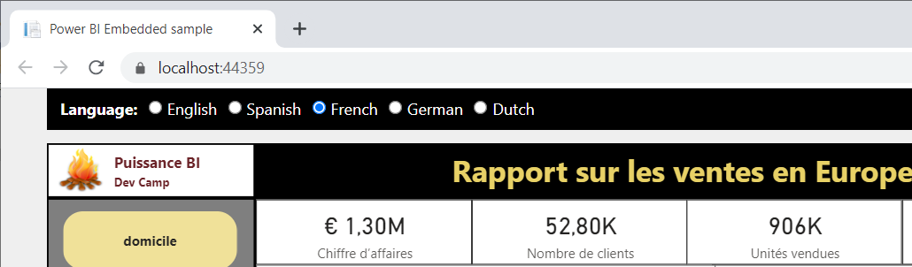
Using localeSettings in Embed Config
You can load report using specific locale by adding localeSettings in embed config
This technique will change result for UserCulture function in DAX

Slide 23
Summary
Overview of Multi-language PBIX Development
Designing Multi-language Reports
Adding Metadata Translations with TOM
Designing Data Models to Support Content Translations

